Slide 1
CONTACT
REGULATION
THERMOGRAPHY
A GLOBAL FUNCTIONAL
AND ENERGETIC DIAGNOSTIC

Slide 2
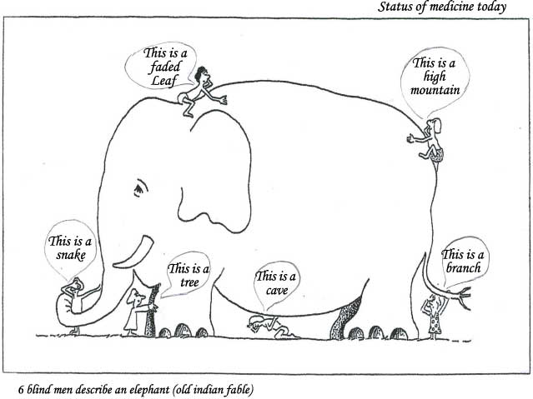

Slide 3
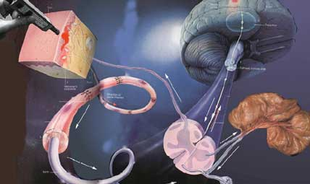
How does it work?

Slide 4
Impulses coming from organs glands and tissues alter various properties of the skin, like the temperature, perspiration, the mechanical tonus and sensitivity.
Consequently, pathological changes of an inner organ can locally influence the metabolism, temperature and other properties of the skin via this reflex arc.
This phenomena is the basis of CRT.

Slide 5
Thermal regulation is never seen as static.
It is viewed as snapshots of a perpetual regulatory process.
It’s Dynamic!!!
Living movement!

Slide 6
The Procedure
A 30-minute CRT examination involves the contact application of a skin temperature sensor probe to take two readings consisting of 119 measurements each.

Slide 7
The Procedure
First reading consists of 119 measurements as the patient progressively undresses except for underwear.
10-minute wait without clothing to expose the body to a cool temperature change.
Second reading of 119 points is repeated.

Slide 8
In the Ideal Regulation Thermogram We Find:
A radial temperature drop
(from lateral to medial)
A vertical temperature drop
(from cranial to caudal)

Slide 9
The Autonomic Nervous System
Before
Stimulus:
33.9° C
The cool-air stimulus induces an autonomic response
The Visceral Cutaneous Reflex, regulated by the autonomic nervous system, describes the physiological communication between the patient’s internal organs and their skin.
After
Stimulus:
32.5° C

Slide 10
Categorizing Reactions
1. Normal Reaction
2. Rigid Reaction
1
3
5
3. Hypo Reaction
4. Hyper Reaction
5. Paradox Reaction
2
4

Slide 11
Normal Reactions
The physiological reaction for the head, dental, and thyroid regions is to first warm up, and then cool down.
The expected reaction after the cooling stimulus that we apply is a temperature increase of approximately 0.3°C.
In the other regions of the body, the normal reaction is a temperature decrease of 0.5 – 1.0°C.

Slide 12
Rigid Reactions
A Rigid or Fixed Reaction occurs when the second measurement is largely unchanged from the first measurement.
This is often an indication of a blockage, disturbed organ, or that the autonomous nervous system has no regulative influence on the reaction.

Slide 13
Hyper Reactions
A Hyper Reaction occurs when the patient overreacts to stimulus.
‘Allergic/Toxic’
This is typical of patients with allergies or autoimmune syndromes.

Slide 14
Paradoxical Reactions
A Paradox Reaction occurs when the measurement of a point after cooling is the opposite of what is expected.
Paradox Reactions usually indicate disease processes, particularly inflammation, or maybe a cancerous terrain.

Slide 15
Temperature Side Difference
Normal
< 0.3°C
Significant
0.3 – 0.7°C
High
> 0.7°C
The direction of the arrow points to the side (left or right) with a higher temperature. This is the side that should be further evaluated.
If there is a temperature difference in A, but not a temperature difference in B, the region is of decreased concern because compensation has taken place.

Slide 16
Temperature Side Difference
Physiologically, we expect the temperatures of the body to be symmetrical – that is, the left and right sides should be temperature identical.
Temperature Side Differences of both the first and second reading are marked on the thermogram by columns of color-coded symbols.
© 2010, Eidam Diagnostics Corp., Reprinted With Permission

Slide 17
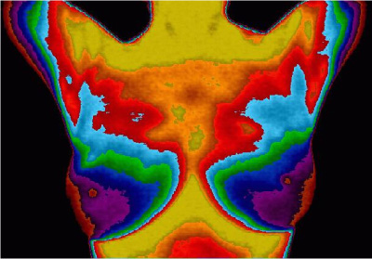
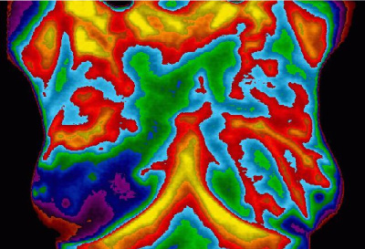
Infrared Thermographic Images
(healthy & cancerous)

Slide 18
Temperature Side Difference
If there is a temperature difference, the side with the higher temperature should be evaluated.
If there is a temp difference in A which is not seen in B, it is a less significant finding.
However, if the difference occurs in B, it is very significant, and should be further evaluated.

Slide 19
Structural Asymmetry
Cranial Asymmetry
Chest Asymmetry
Breast Asymmetry
Sacral Asymmetry
Dental Vector Analysis

Slide 20
The Basis of Harmony is Balanced Symmetry
The less energy required to achieve a balanced state of symmetry, the less energy consumed and the more free energy available.

Slide 21
Chaos Index Values
The Chaos Index can be a strong indicator of a disease process in a region:
0 – 2 Normal
2 – 4 Normal - Borderline
4 + Unfavorable
When CI in A or B is greater than 5, additional screening diagnosis should be strongly considered.

Slide 22
The highest CI values indicate the most chronically affected organs
This index shows the area with the
priority for therapy.

Slide 23
Is There Elevated Chaos?
When CI in A or B is greater than 5, additional screening diagnosis should be strongly considered.
Abnormal if CI-B is greater than CI-A – “rising”.

Slide 24
The Chaos Index
CI-A Chaos Index for the System at Rest
CI-B Chaos Index for the System following stress
The Chaos Index is the most important therapeutic index used to compare a patient at rest and after stress.
If CI-B exceeds CI-A by 0.5 or more in any region, that region is an area of concern that requires further
investigation.

Slide 25
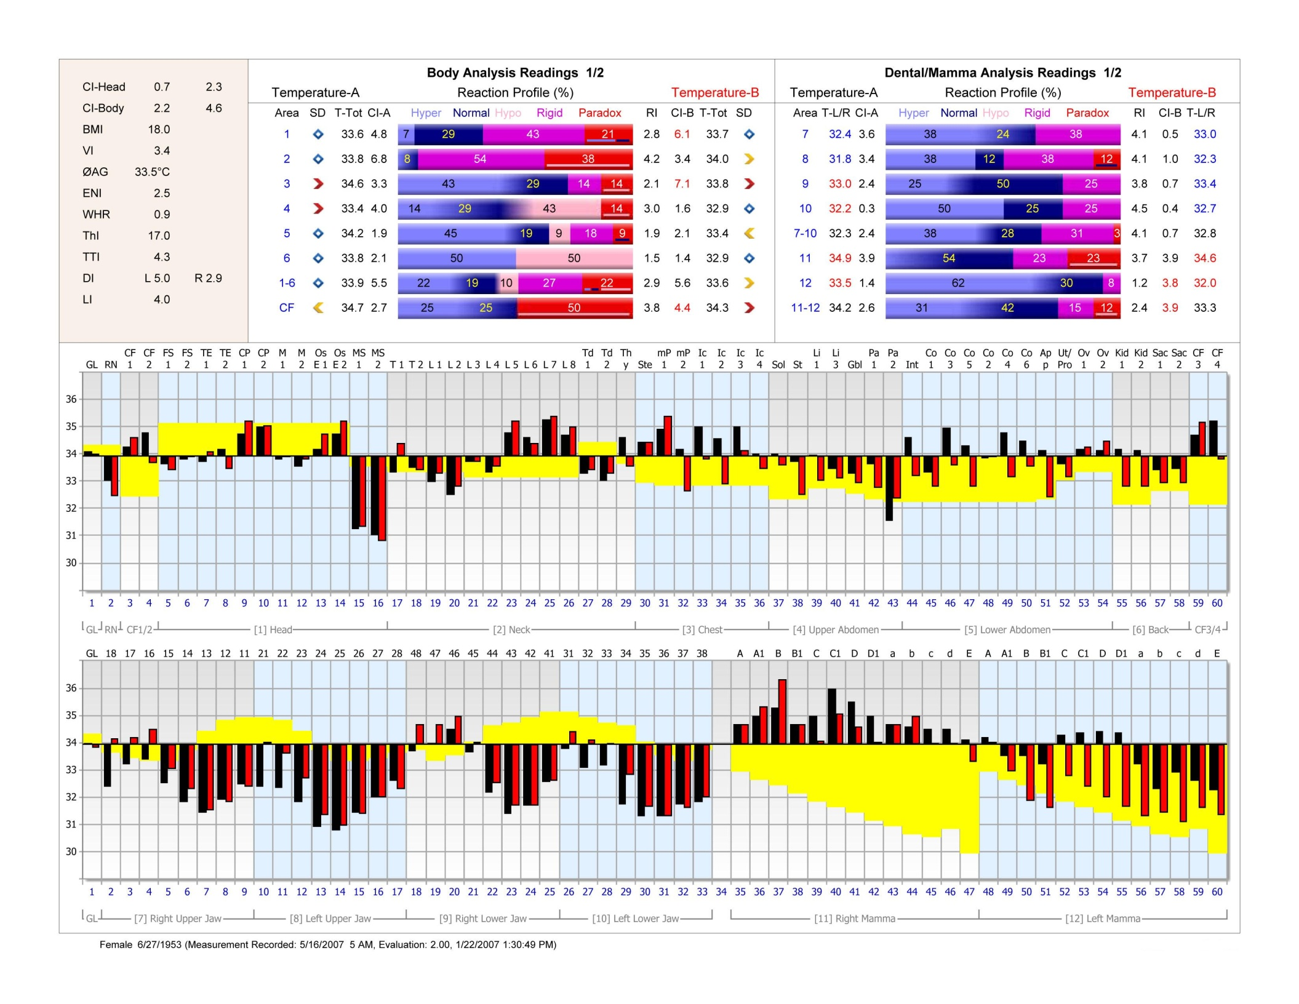
Chaos Index

Slide 26
Warm Liver/GB
Cold Stomach Pancreas

Slide 27
Vitality Index
The average temperature value (T-total A 1-6) of patients of various age groups falls between 33.0 C. (80 Y/O) and 34.3 C. (10 Y/O).
The VI express the relation between the actual temperature and the statistical temperature according to age groups.
© 2006, Eidam Diagnostics Corporation, Reprinted with Permission
.

Slide 28
Vitality Index
The Vitality Index (VI) is an indicator for the patient’s metabolic activity with respect to their age group. Scale value is from 1-6.
> 3.8 Excessively high metabolic activity
3.0 Average normal value
2.5 - 3.8 Normal Metabolic Activity
2.0 - 2.5 Low metabolic activity
< 2.0 Very low metabolic activity

Slide 29
Low Vitality Index <2
A low Vitality Index is commonly found in patients with the following conditions:
Chronic disease
Chronic autoimmune disease
Hypothyroidism
Viral Infections
Depression
Low metabolic activity
Elderly and Pre-aged patients

Slide 30
High Vitality Index >4
An excessively high Vitality Index is commonly found in patients with the following conditions:
Physically Active
Younger Patients
Hyperthyroidism
High Metabolic Activity
Hormonal Disorders
Progressive Cancer

Slide 31
Lymphatic Index
The Lymphatic Index (LI) is a marker for the lymphatic system and indicates the correlation of the lymph measurement areas and the immune system.
0 – 2 Normal reaction and high level
of immune function
2 – 4 Reduced immune function and
borderline lymphatic congestion
4 – 6 Blocked immune response
and high lymphatic congestion

Slide 32
Area 1 Head Points
GL – glabella - reference point
RN - radix nasi - circulation
FS 1 - frontal sinus R
FS 2 - frontal sinus L
T 1 - temple R – pituitary; brain; external carotid
T 2 - temple L – pituitary; brain; external carotid
CP 1 - commissura palpebrarum medialis R – internal carotid; brain; sinus
CP 2 - commissura palpebrarum medialis L – internal carotid; brain; sinus
M 1 - Mastoid 1 R - atlas/axis, R/L asymmetry = subluxation; inner ear; brain
M 2 - Mastoid 2 L - atlas/axis, R/L asymmetry = subluxation; inner ear; brain
OsE 1 - os ethmoidale R – immunity, R/L asymmetry suggest chronic virus
OsE 2 - os ethmoidale L – immunity, R/L asymmetry suggest chronic virus
MS 1 - maxillary sinus R
Ms 1 - maxillary sinus L

Slide 34
Do Brain Points Exhibit Warming Regulation?
Are They Symmetrical?
Look for temp differences > 0.3
Are they below baseline?

Slide 35
Area 2 Neck Points
T 1 – tonsil R
T 2 – tonsil L
L 1 – inframandibular gland R
L 2 – inframandibular gland L
L 3 – ventral edge of m. sternocleidomastoideus R
L 4 – ventral edge of m. sternocleidomastoideus L
L 5 – supraclavicular fossa R
L 6 – supraclavicular fossa L
L 7 – infraclavicular fossa R
L 8 – infraclavicular fossa L
Td 1 – thyroid lobe R
Td 2 – thyroid lobe L
Thy - thymus

Slide 36
Thyroid
Thyroid values, like brain points, should regulate with a warming response
Is Thyroid cooling (paradoxical) or rigid?
Are values below baseline?
Is there symmetry?

Slide 37
Area 3 Chest Points
Sternum
Pectoris right
Pectoris left
Intercostal right IC1
Intercostal left IC2
Intercostal right IC3
Intercostal left IC4 - cardiac

Slide 38
Rigid Sternum
Investigate!!!
Mamma?

Slide 39
Suspicious!!!

Slide 40
Area 4 Upper Abdomen Points
Solar Plexus
Stomach
Liver 1
Liver 3
Gall Bladder
Pancreas 1 (head)
Pancreas 2 (tail)

Slide 41
Intestinal Mycosis
Cold Stomach!!
Coldest 2nd measurement in area 4 stomach point
This may accompany RI <1.0 in area 4. – “toxic stress”

Slide 42
Area 5 Lower Abdomen Points
Small Intestine
Colon 1-hepatic flexure)
Colon 2-splenic flexure)
Colon 3 (ascending)
Colon 4 (descending)
Colon 5 (cecum)
Colon 6 (descending sigmoid area)
Appendix
Uterus/Prostate
Ovary/Lymph right
Ovary/Lymph left

Slide 43
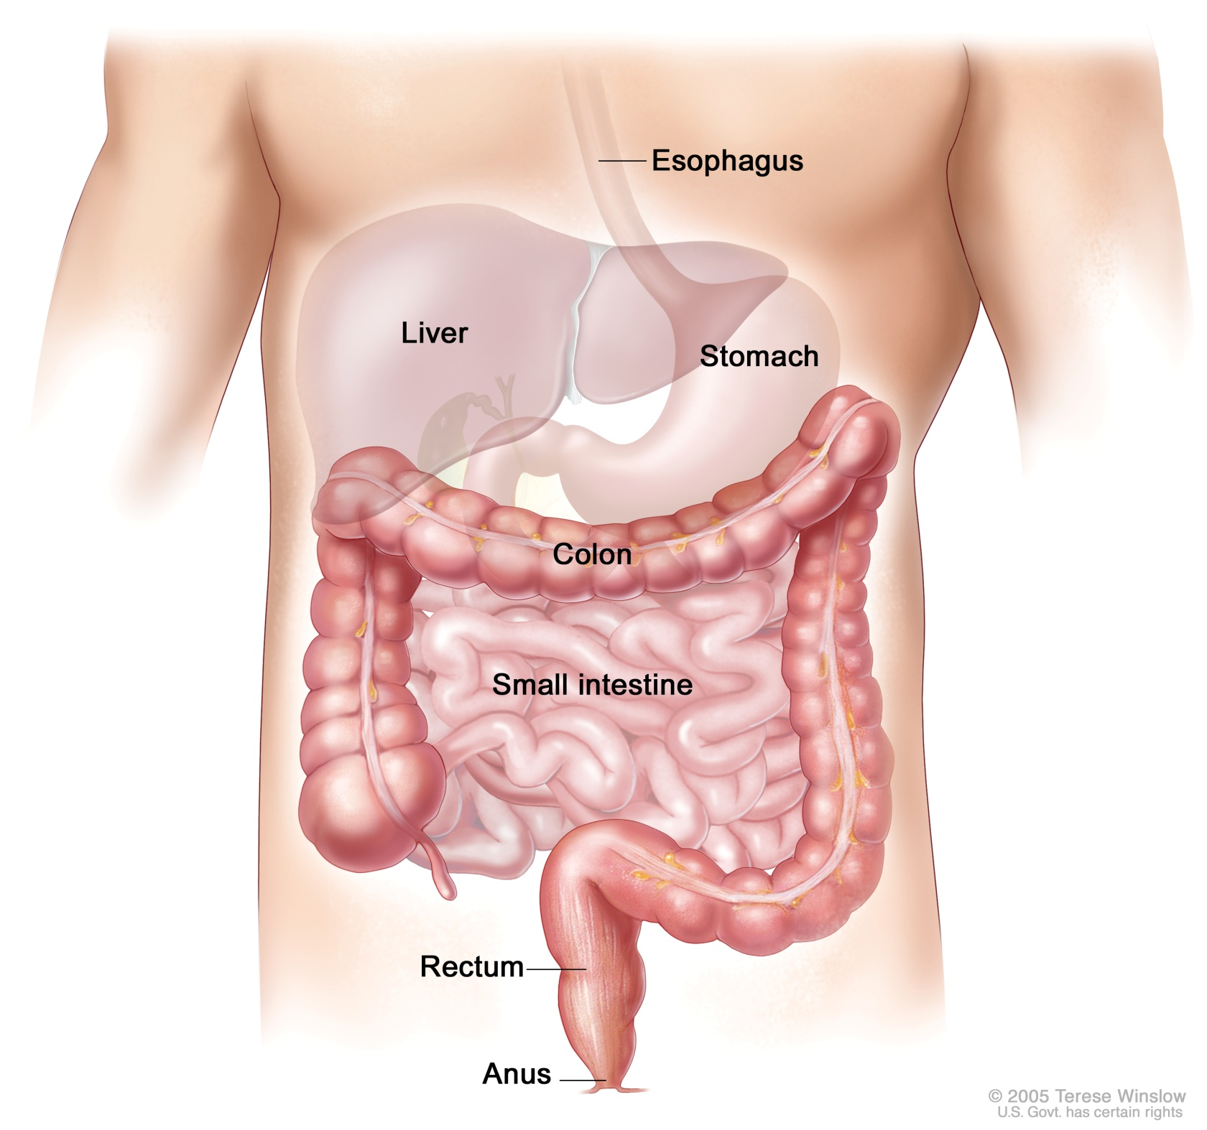
CO
2
CO
1
CO
3
CO
4
SI
CO
5
CO
6

Slide 44
Food Allergy ‘Bridge’

Slide 45
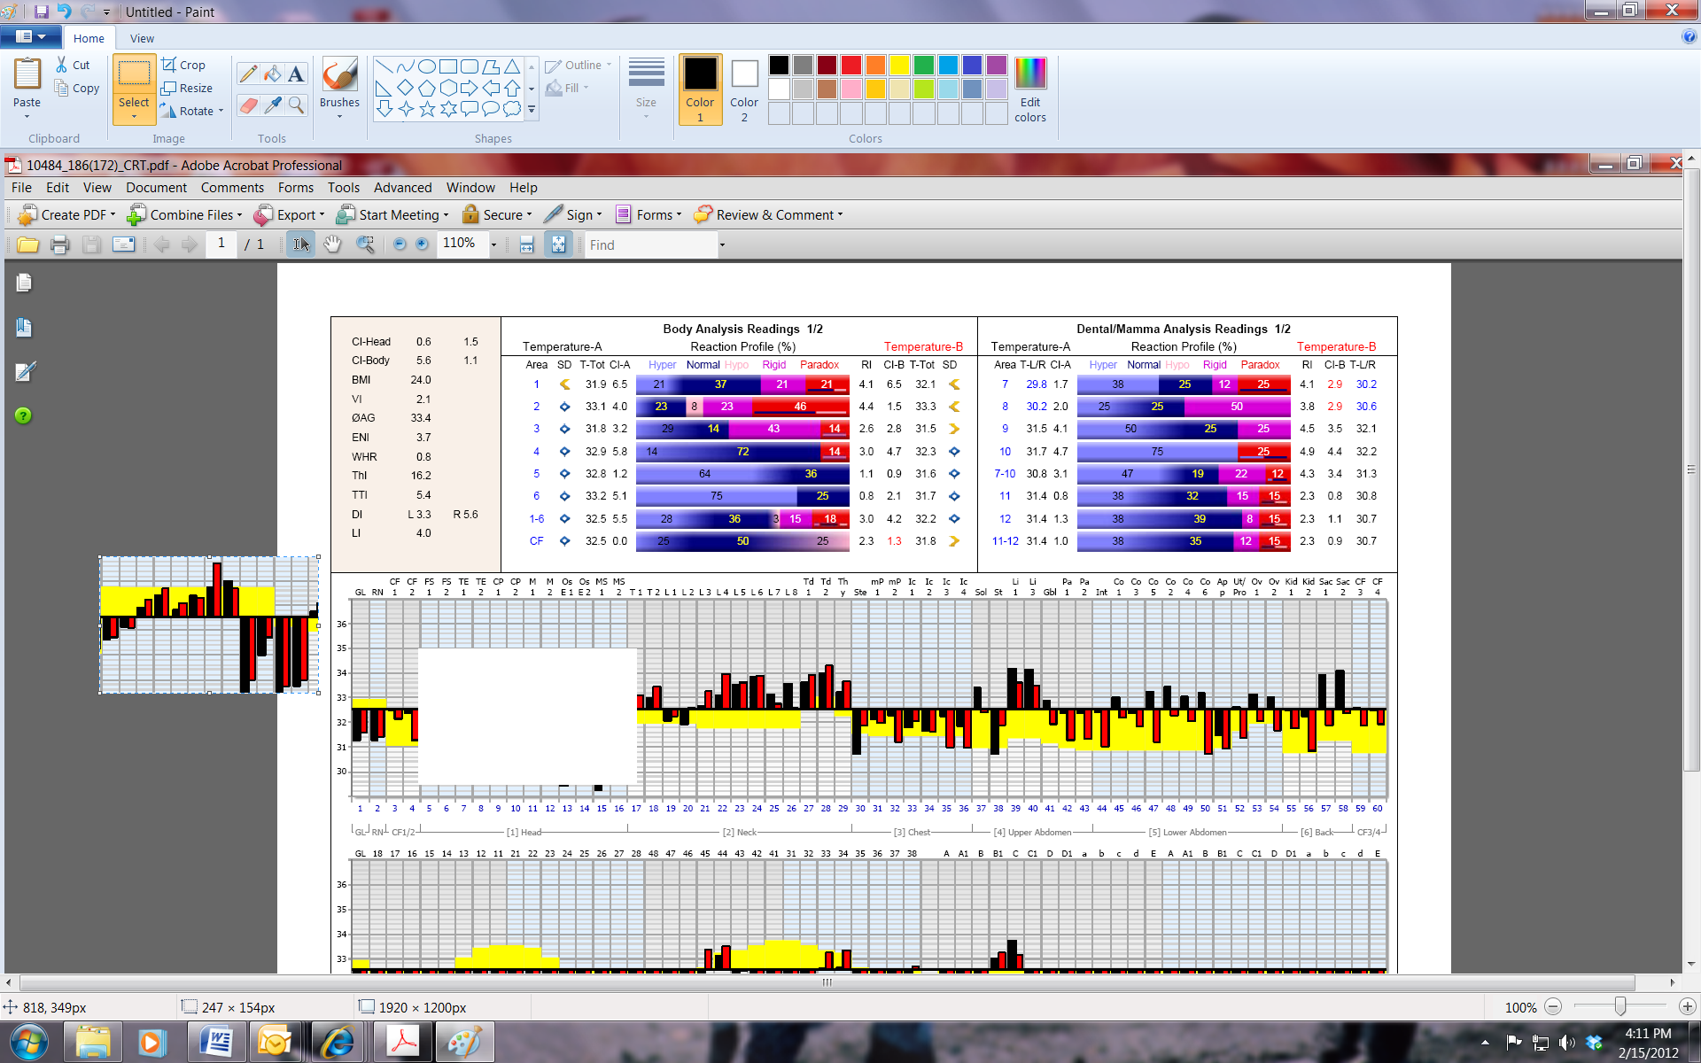
Fermentive Dyspepsia
Inflammation
Descending
Pattern
Descending Stair-step
Pattern

Slide 46
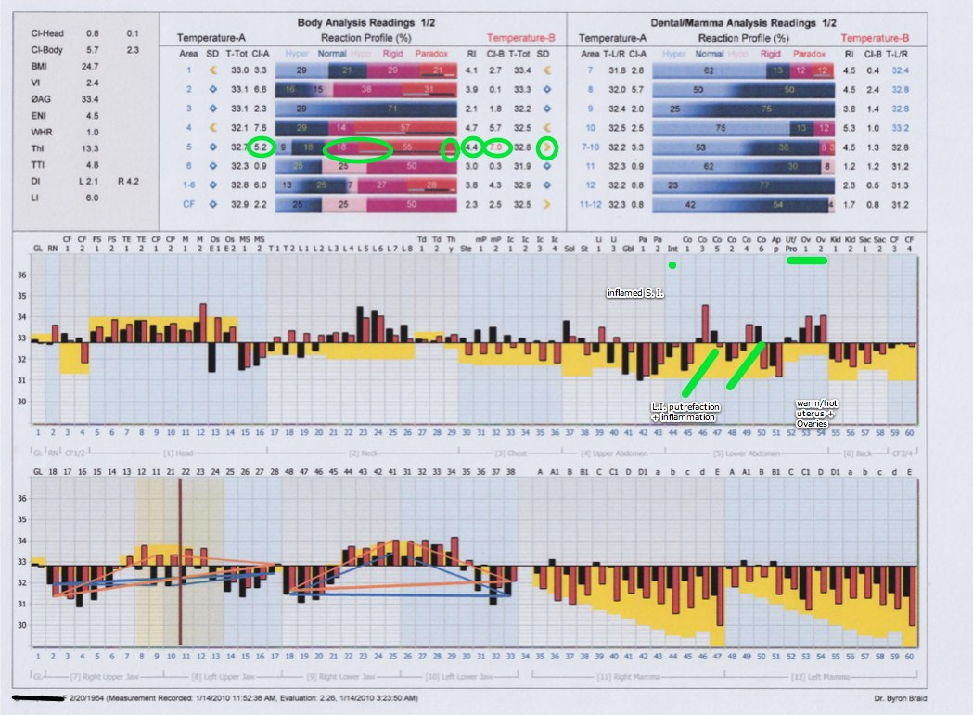
Putrefactive Dysbiosis
Descending
Pattern
Ascending Stair-step
Pattern

Slide 47
Area 6 Back Points
Kidney 1 right
Kidney 2 left
Sacroiliac 1 right
Sacroiliac 2 left

Slide 48
Dental
Dental Points like head points should increase in temperature
Look for Rigid Quadrants
It has been found that when 3-4 quadrants have more than 15% rigid regulation in the RP, there is a mercury amalgam issue.

Slide 49
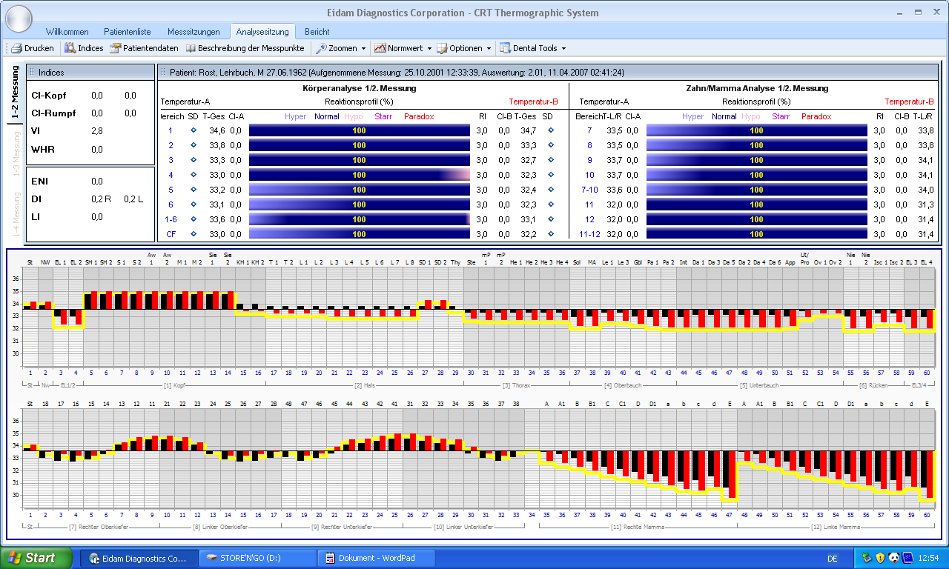
Sine wave consistency is a sign of health.
The posterior teeth must be cooler than the anterior ones, thus forming a sine wave in the thermographic result.

Slide 50
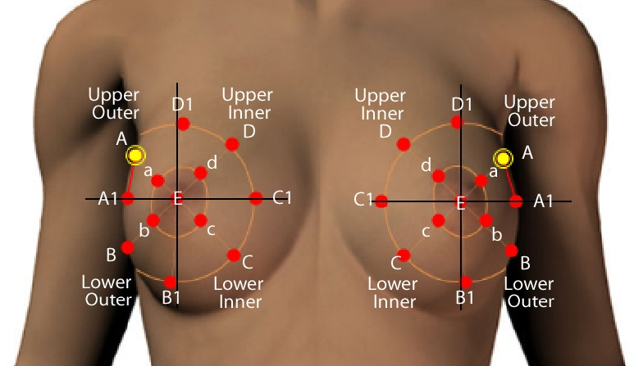
Mamma Points

Slide 51
Investigate Symmetry

Slide 52
Mamma Pathology
Most Important:
Hot spot in mamma
Rigid point in mamma
Mamma asymmetry >.7
Chest asymmetry >.5
mP hot / asymmetry
Sternum rigid
Rising CI-B Mamma
Rising CI-B Area 3
Helpful Markers:
Tonsils rigid/paradox
same side tonsil as hot spot in mamma
Stomach rigid/cold
Liver/Pa abnormal
Dental Foci Pattern – DFI > 3 (2nd molar?)
Contra-ovary rigid

Slide 53
Breast Cancer Example
Patients who are have breast cancer, or who have progressed to develop breast cancer, often have Thermograms that exhibit a number of other characteristics. For example, this patient has a blocked cervical lymph.

Slide 54
Breast Cancer Example
These other characteristics of the patient’s physiological response in the chest and abdominal regions are of additional consideration.
Rigid Sternum
Blocked Liver
Opposite Ovary Block
mP1 Paradox Response

Slide 55
Basic Interpretative Overview
In the beginning: Give yourself at least 20 – 30 minutes to interpret the CRT.
Better to interpret the findings during a break or at the end of the day away from other distractions or time pressures.
Later on, look at it again a second time

Slide 56
Basic Interpretative Overview
Base line – T-total value of A 1-6
Is it above or below norm (VI)?
Physical Indices
Side Differences
Chaos Indices
Reaction Indices
Reaction (Regulation) Profile

Slide 57
Basic Interpretative Overview
Nasal root – circulation status
Cubital fossae – blockage? sidedness? systemic inflammation?
Area 1: brain symmetry, above baseline? Warming?
Sinus symmetry, excessively cold or inflammatory?

Slide 58
Basic Interpretative Overview
Area 2: lymph symmetry, paradoxically inflamed or blocked
Compare L5 with L6 (2nd measurement) or L7 with L8 (1st measurement) - does this tell you head or abdomen?

Slide 59
Basic Interpretative Overview
Area 3: Is the sternum rigid?
Look at the solar plexus: is there a major abdominal problem?
Look at the dental thermogram. Does anything look unusual?

Slide 60
Interpretative Overview
Look at the breast thermogram. Are there hot spots or rigid areas?
Mamma R – L asymmetry > 0.7 C.?
Chest R – L asymmetry > 0.5 C.?
Does it correlate chest asymmetry, pectoris asymmetry sternum regulation, ovary readings?
Now look at thermogram comprehensively

Slide 61
Interpretative Overview
Integrate the themes and develop the meridian correspondences

